Slide 1
Arithmetic Operators
Arithmetic operators are binary operators because they work with two operands, with the operator being placed in between the operands.
These operators allow you to perform computations on numeric or string data.

Slide 2
Arithmetic Operators
+
-
/
*
%

Slide 3
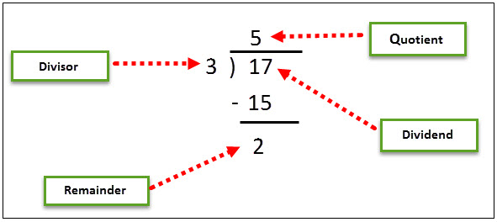
Arithmetic Operators

Slide 4
Relational Or Comparison Operators
Relational operators make a comparison between two operands and return a boolean value, true, or false.
==
!=
>
<
>=
<=

Slide 5
Logical Or Conditional Operators
logical operators perform boolean logical operations on both the operands. They return a boolean value based on the logical operator used.
There are two types of conditional operators.
CONDITIONAL AND (&&)
CONDITIONAL OR (||).

Slide 6
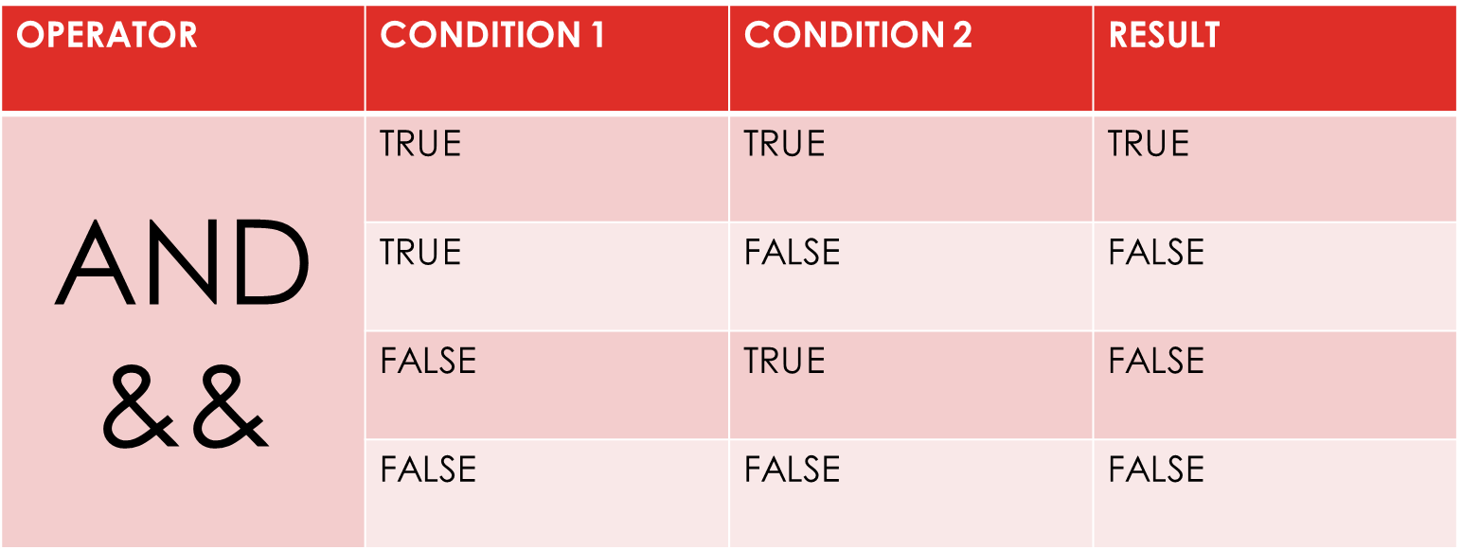
Logical OR CONDITIONAL Operators
logical operators perform boolean logical operations on both the operands. They return a boolean value based on the logical operator used.
There are two types of conditional operators.
CONDITIONAL AND (&&)
CONDITIONAL OR (||).

Slide 7
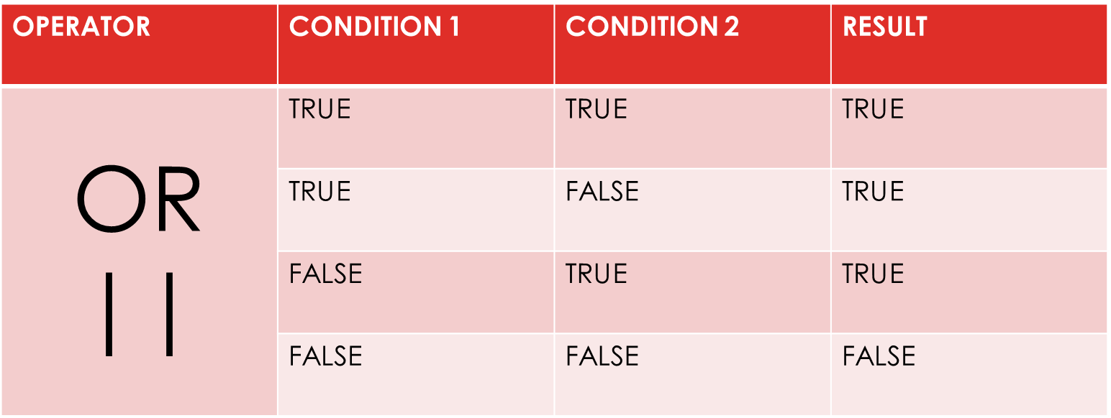
Logical OR CONDITIONAL Operators
logical operators perform boolean logical operations on both the operands. They return a boolean value based on the logical operator used.
There are two types of conditional operators.
CONDITIONAL AND (&&)
CONDITIONAL OR (||).

Slide 8
Assignment Operators
Assignment operators are used to assign the value of the right side operand to the operand on the left side using the equal to operator (=).
The assignment operators are divided into two categories in C#. These are as follows:
Simple assignment operators: The simple assignment operator is =, which is used to assign a value or result of an expression to a variable.
Compound assignment operators: The compound assignment operators are formed by combining the simple assignment operator with the arithmetic operators.

Slide 9
ASSIGNMENT OPERATORS
Compound assignment operators:
+=
-=
*=
/=
%=

Slide 10
Increment And Decrement Operators
Two of the most common calculations performed in programming are increasing and decreasing the value of the variable by 1.
In C#, the increment operator (++) is used to increase the value by 1 while the decrement operator (--) is used to decrease the value by 1.
If the operator is placed before the operand, the expression is called pre-increment or pre-decrement.
If the operator is placed after the operand, the expression is called post-increment or post-decrement.

Slide 11
Ternary Or Conditional Operators
C# includes a special type of decision making operator ? : called the ternary operator.
Syntax:
Boolean Expression ? First Statement : Second Statement

Slide 12
Precedence Of Operators
Operators in C# have certain associated priority levels.
The C# compiler executes operators in the sequence defined by the priority level of the operators.
EXAMPLE:
8 / 2 - 3 + 2 * 2

